Slide 1
Computer Vision – Module 2
Dr. Sreejith Rajan

Slide 2
Image Enhancement - Overview
Image enhancement improves visual quality or prepares image for further processing.
Enhancement includes:
Contrast enhancement
Intensity normalization
Smoothing
Noise removal
Important:
👉 Enhancement improves perception 👉 It does NOT add new information

Slide 3
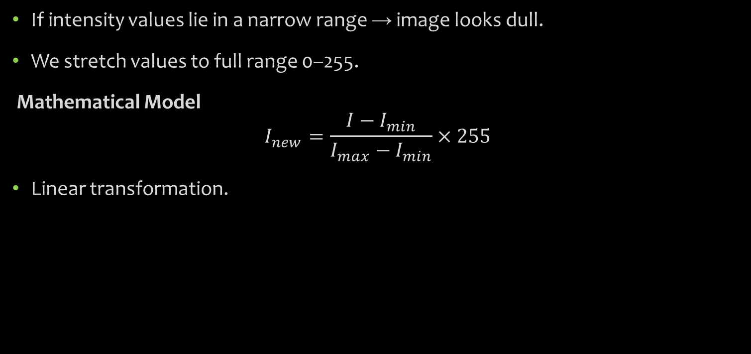
Contrast Enhancement
If intensity values lie in a narrow range → image looks dull.
We stretch values to full range 0–255.
Mathematical Model
$$I_{new}=\frac{I−I_{min}}{I_{max}−I_{min}}×255$$
Linear transformation.

Slide 4
Characteristics
✔ Global operation ✔ Preserves relative brightness ✔ Does NOT remove noise ✔ Improves dynamic range
Applications
X-ray image improvement
Satellite images
Underexposed images

Slide 5
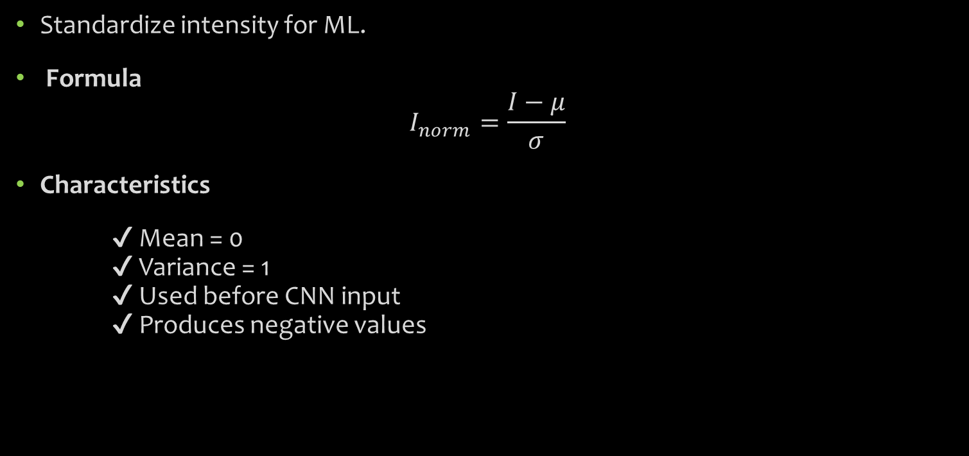
Contrast Normalisation
Standardize intensity for ML.
Formula
$$I_{norm}=\frac{I−μ}{σ}$$
Characteristics
✔ Mean = 0 ✔ Variance = 1 ✔ Used before CNN input ✔ Produces negative values

Slide 6
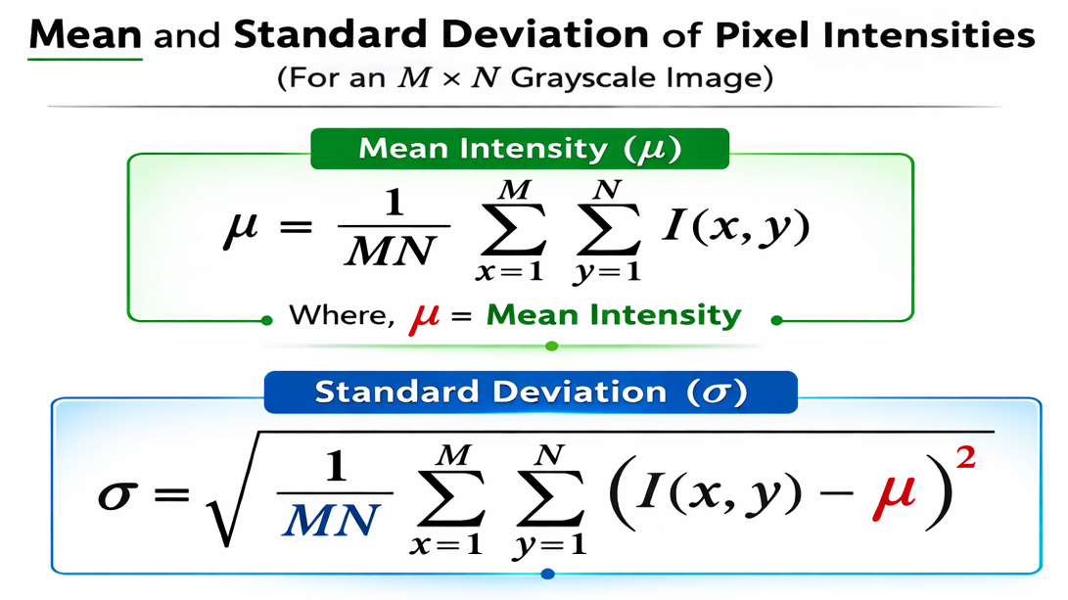
mean = average intensity of all 65,536 pixels
std = spread of intensity values (contrast measure)

Slide 7
Image Smoothing
Reduce high-frequency components (noise).
Noise = rapid pixel fluctuations.
Smoothing = Low-pass filtering.
Types of smoothing
Mean filter
Gaussian Filter
Median Filter

Slide 8
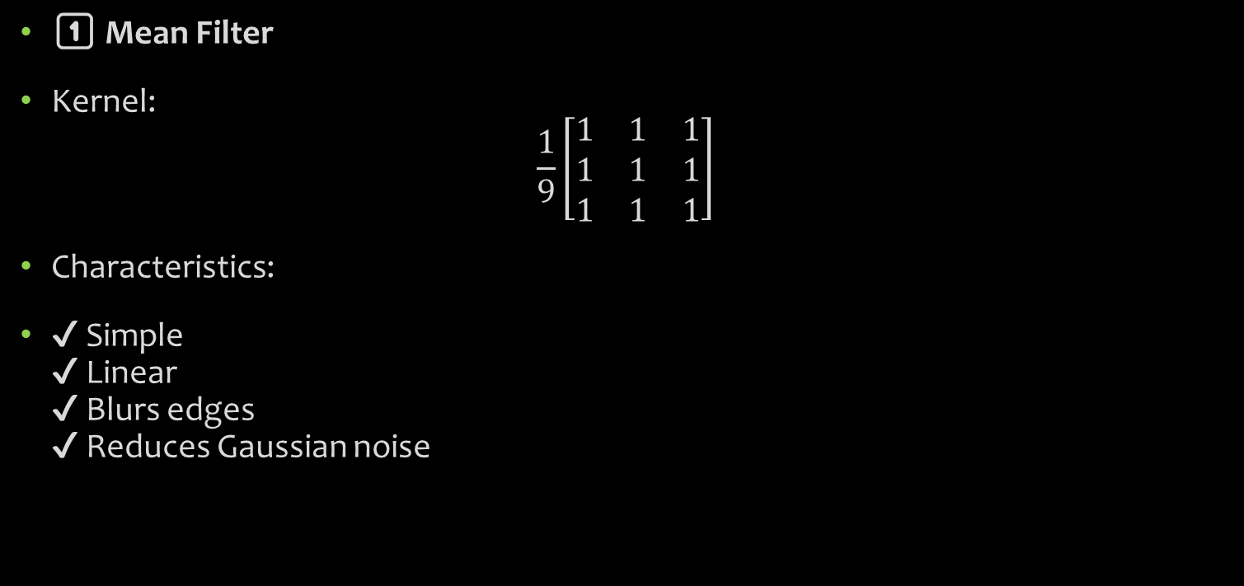
Mean Filter
1️⃣ Mean Filter
Kernel:
$$\frac{1}{9}\left[\begin{matrix}1 & 1 & 1 \\ 1 & 1 & 1 \\ 1 & 1 & 1\end{matrix}\right]$$
Characteristics:
✔ Simple ✔ Linear ✔ Blurs edges ✔ Reduces Gaussian noise

Slide 9
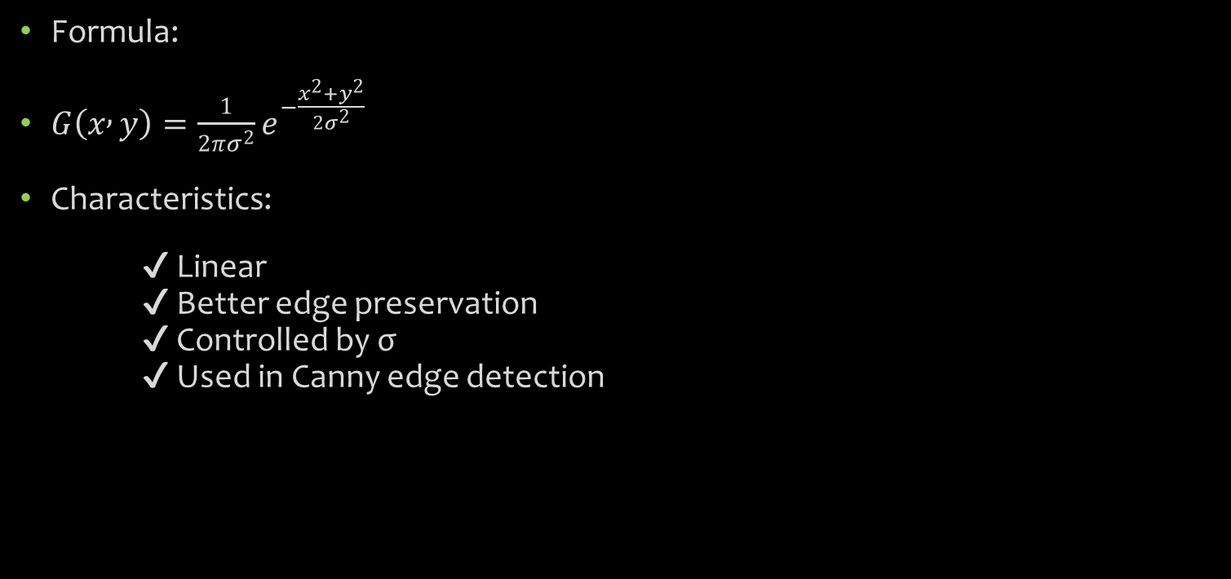
Gaussian Filter
Formula:
$G\left(x , y\right)=\frac{1}{2πσ^{2}}e^{−\frac{x^{2}+y^{2}}{2σ^{2}}}$
Characteristics:
✔ Linear ✔ Better edge preservation ✔ Controlled by σ ✔ Used in Canny edge detection

Slide 10
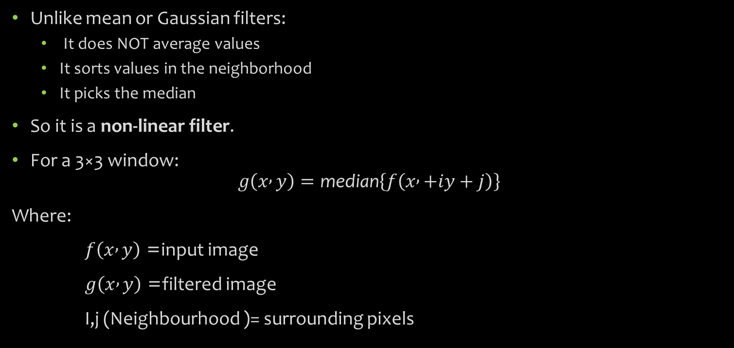
Median Filter
Unlike mean or Gaussian filters:
It does NOT average values
It sorts values in the neighborhood
It picks the median
So it is a non-linear filter.
For a 3×3 window:
$$g\left(x , y\right)=\text{median}\left\{f\left(x , +iy+j\right)\right\}$$
Where:
$f\left(x , y\right)$= input image
$g\left(x , y\right)$= filtered image
I,j (Neighbourhood )= surrounding pixels

Slide 11
Applications
✔ Biomedical images ✔ Surveillance systems ✔ Faulty sensor correction ✔ Preprocessing before segmentation
Filter | Linear? | Good for Gaussian Noise | Good for Salt & Pepper | Edge Preservation
Mean | Yes | Moderate | Poor | Poor
Gaussian | Yes | Good | Poor | Moderate
Median | No | Moderate | Excellent | Excellent

Slide 12
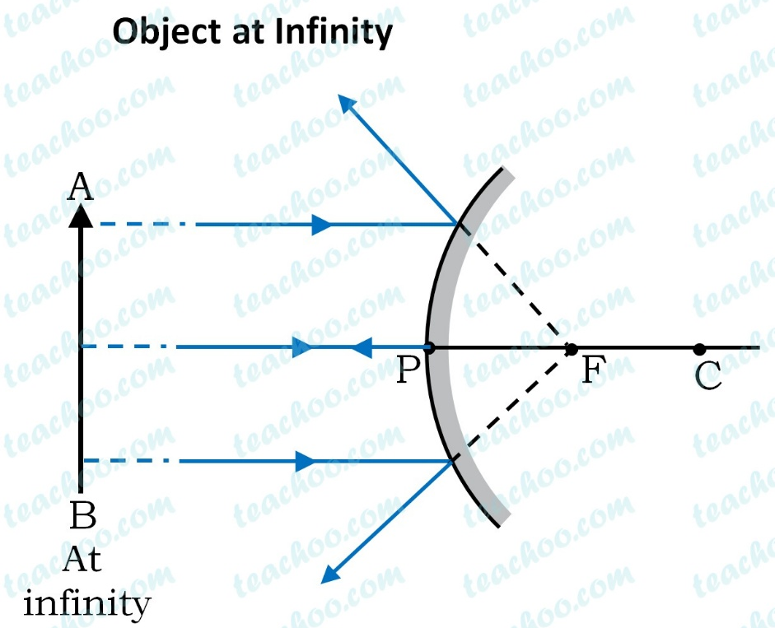
Convex Mirror
Incident ray hits curved surface
Normal again passes through centre of curvature
Reflection obeys 𝑖=𝑟
Reflected rays diverge
Extensions meet at a virtual focus behind mirror

Slide 13
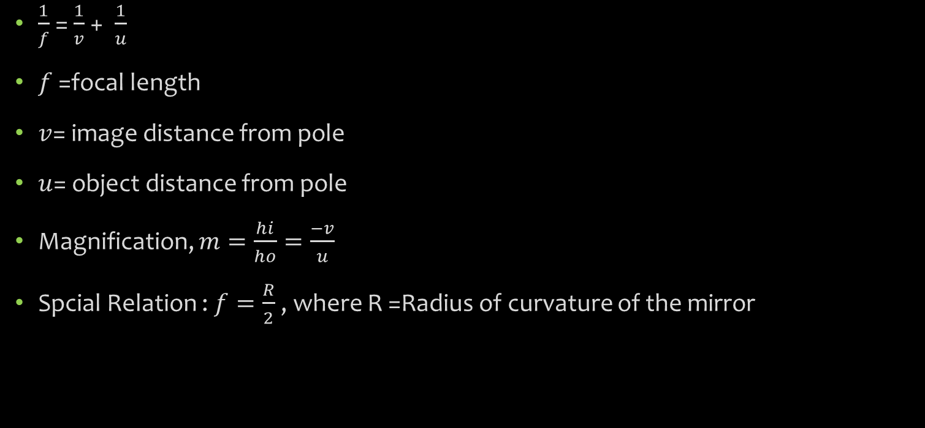
Mirror Equations
$\frac{1}{f}$ = $\frac{1}{v}$ + $\frac{1}{u}$
$f$ =focal length
$v$= image distance from pole
$u$= object distance from pole
Magnification, $m=\frac{hi}{ho}=\frac{−v}{u}$
Spcial Relation : $f=\frac{R}{2}$ , where R =Radius of curvature of the mirror

Slide 14
Spherical Lenses
Lenses Obey Snell’s law of refraction
n₁sin i=n₂sinr
This applies at each refracting surface of the lens.
Why lenses bend light
Light enters glass → slows down → bends towards normal
Light exits glass → speeds up → bends away from normal
Net result: convergence or divergence

Slide 15
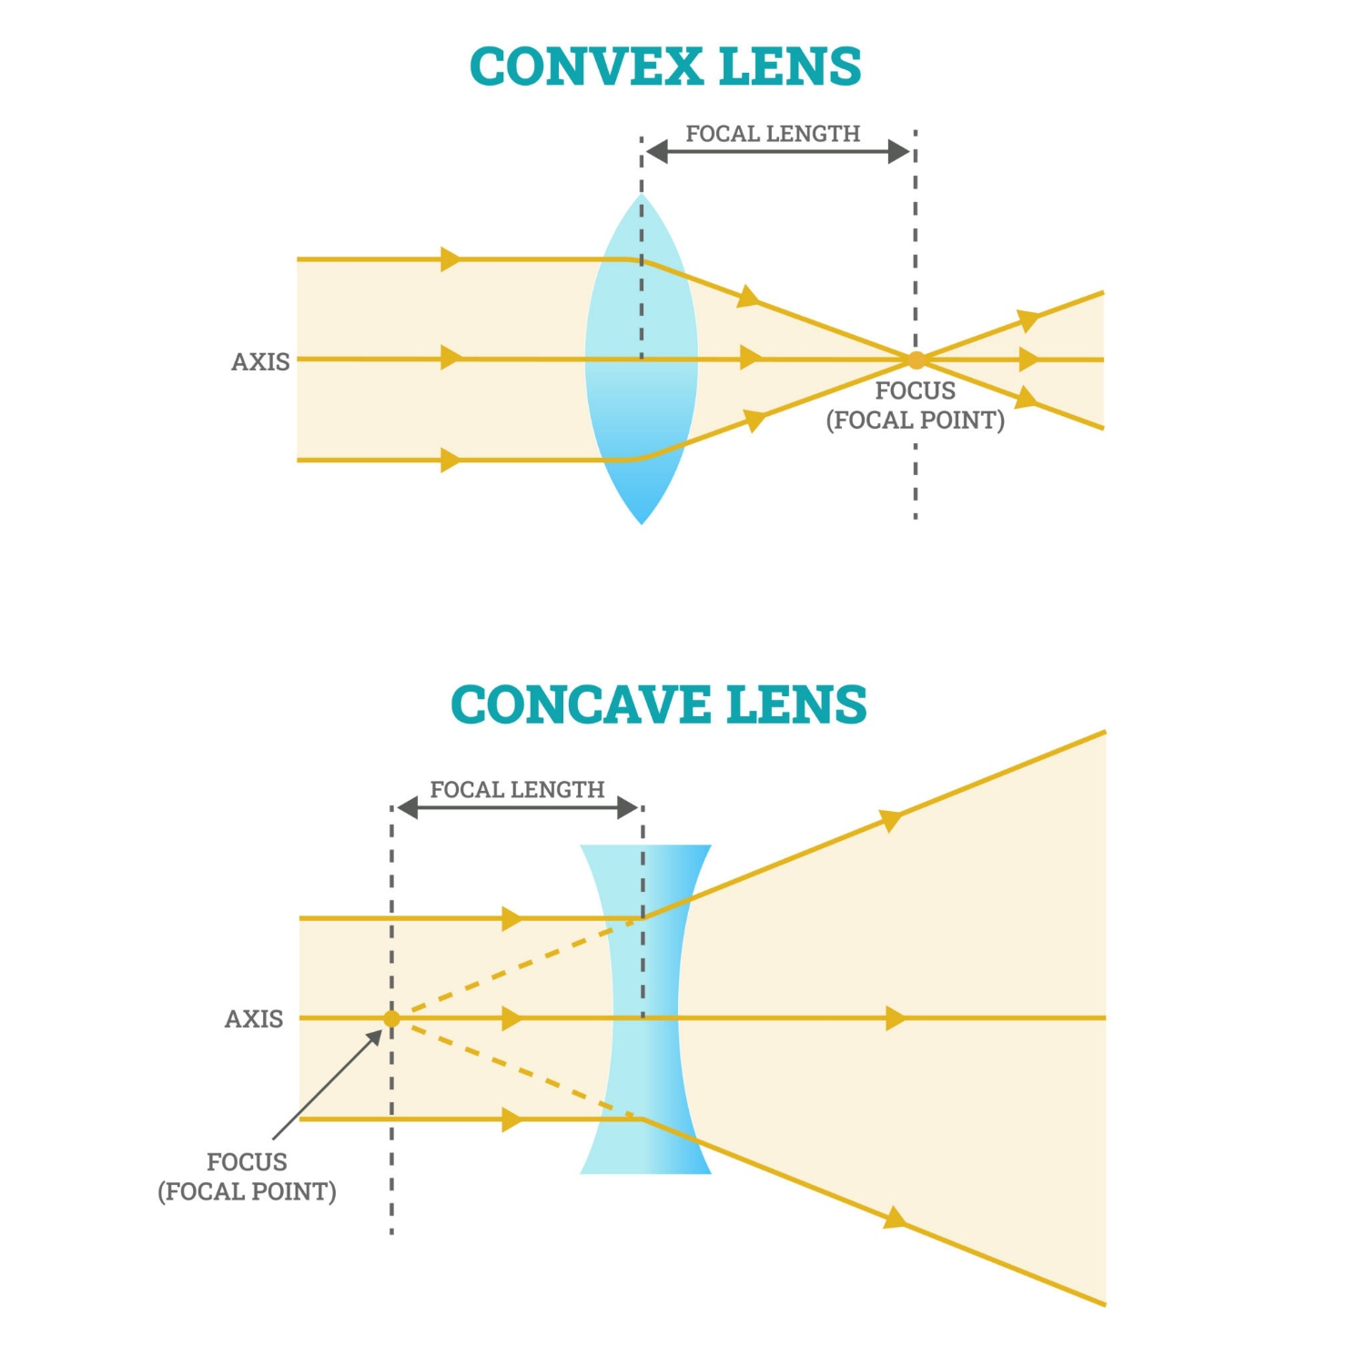
Convex lens
Ray enters lens from air to glass → refracts towards normal
Ray exits glass to air → refracts away from normal
Due to curved surfaces, rays converge
Rays meet at the real focus on the opposite side

Slide 16
Concave Lens
Refraction at first surface causes divergence
Second refraction increases divergence
Rays appear to come from a virtual focus
Image is always virtual and diminished

Slide 17
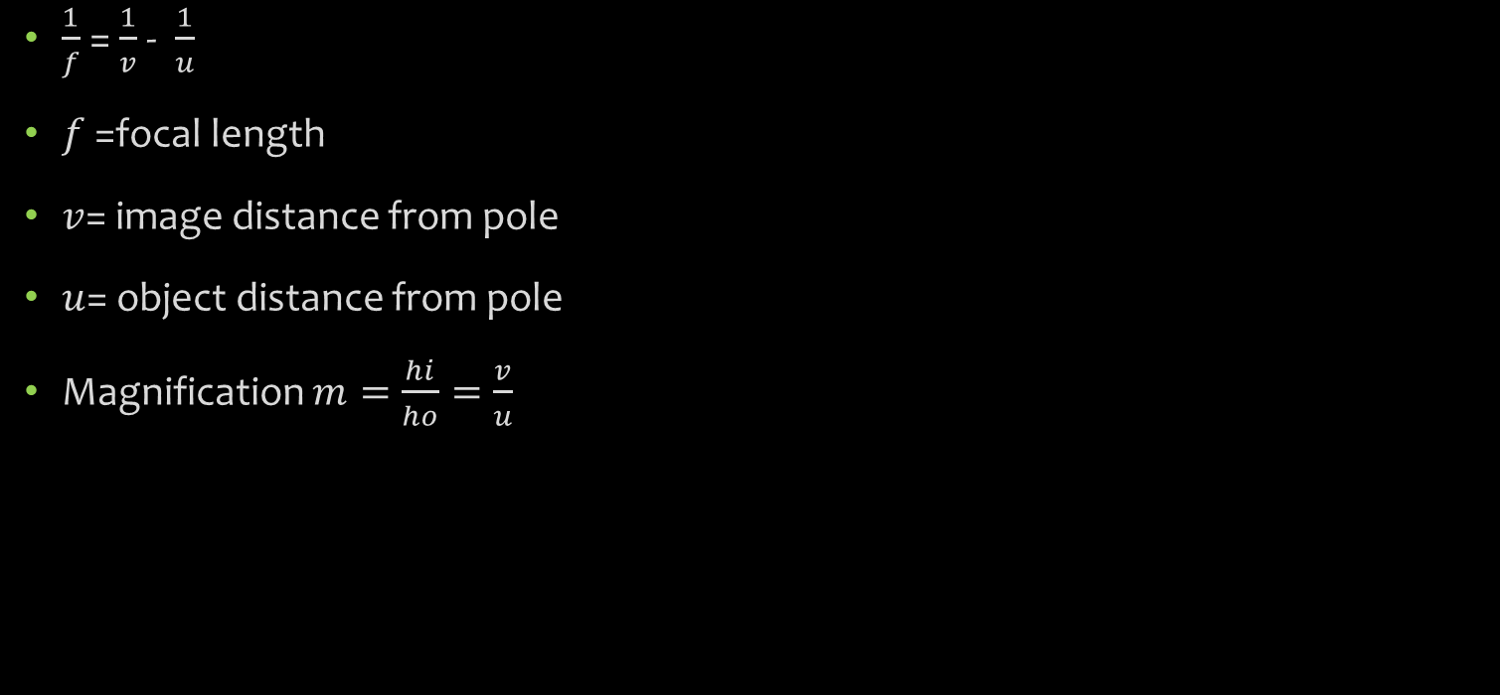
Lens Equations
$\frac{1}{f}$ = $\frac{1}{v}$ - $\frac{1}{u}$
$f$ =focal length
$v$= image distance from pole
$u$= object distance from pole
Magnification $m=\frac{hi}{ho}=\frac{v}{u}$

Slide 18
Lens vs Mirror
Aspect | Mirrors | Lenses
Physical process | Reflection | Refraction
Governing law | ( i = r ) | Snell’s law
Medium change | No | Yes
Image formation | Single interaction | Two refractions
Gaussian optics role | Geometry | Approximation

Slide 19
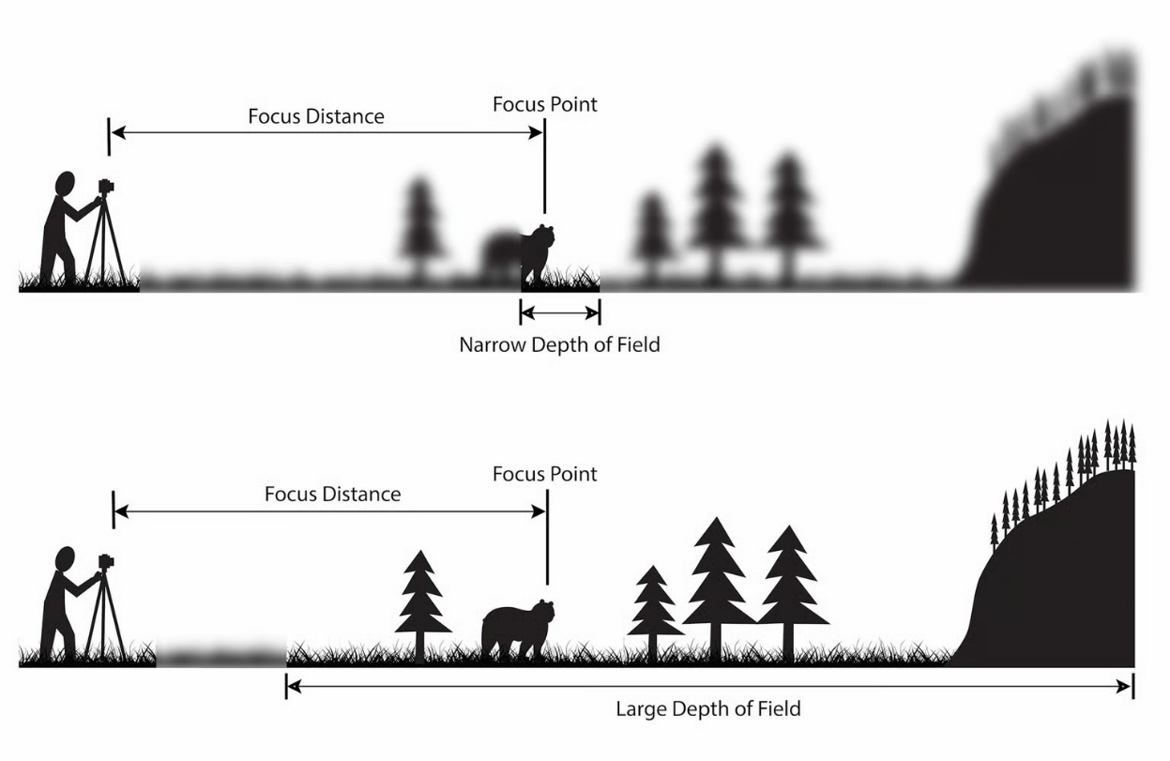
Depth of Field
Depth of field is the distance between the closest and farthest objects in a photo that appears acceptably sharp.
Now your camera can only focus sharply at one point. But the transition from sharp to unsharp is gradual, and the term ‘acceptably sharp’ is a loose one
Credits : Elizabeth
https://photographylife.com/what-is-depth-of-field

Slide 20
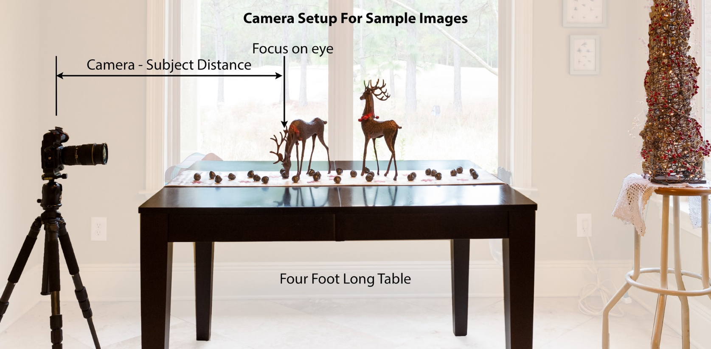
Factors Affecting DoF
Aperture
Camera Subject Distance
Sensor Size

Slide 21
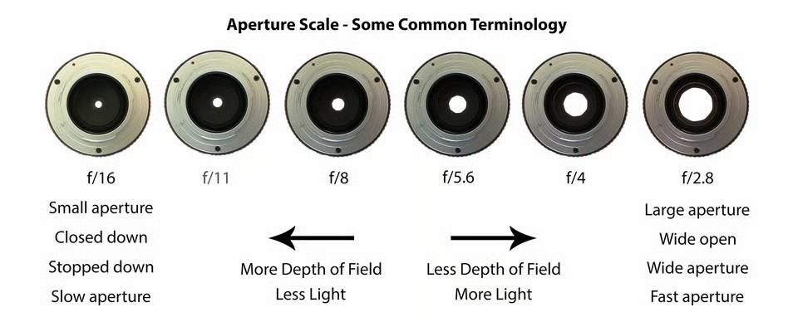
Aperture
Aperture is the opening in the lens that lets light pass through to the sensor.
Think of it as a pupil for your lens. It dilates to let more light in, and contracts to restrict light when it is bright.

Slide 22


Captured with a NIKON D800 and 24-70mm f/2.8 lens @ 24mm, ISO 200, 8/10s, f/22.0
Captured with a NIKON D500 and 17-55mm f/2.8 lens @ 22mm, ISO 200, 1/1600s, f/2.8

Slide 23
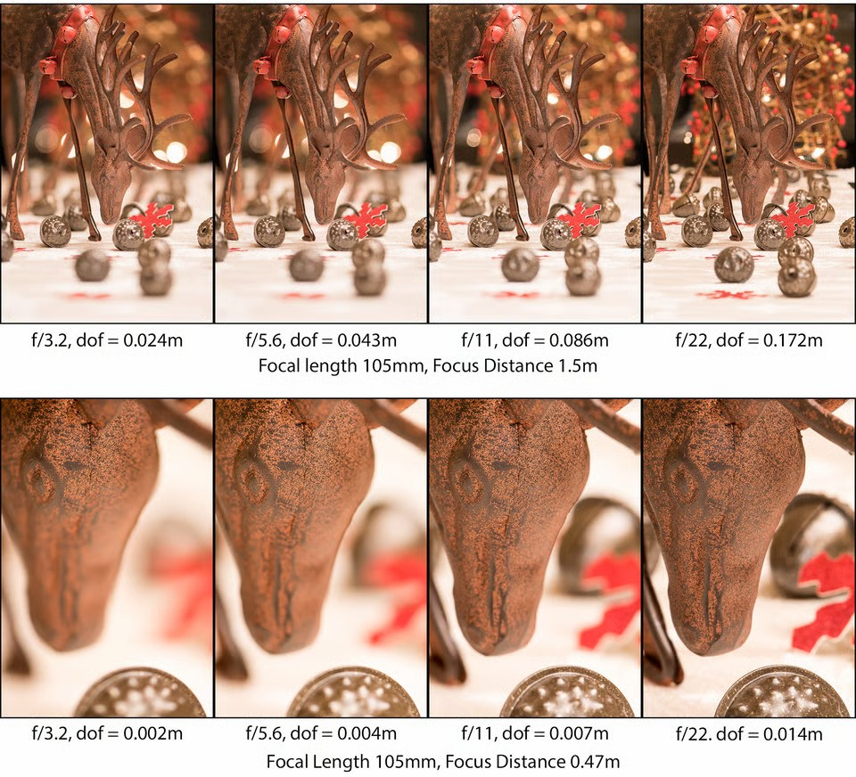
Camera- Subject Distance
The shorter that distance, the smaller the depth of field.

Slide 24
Telecentric Lens
Telecentric lenses are designed to have a constant magnification regardless of the object's distance or location in the field of view.
This attribute is ideal for many machine vision measurement applications, as measurements of an object's dimensions will be independent of where it is located.
In order to achieve a telecentric lens design, all of the chief rays (rays from an off-axis point that pass through the centre of the aperture stop) have to be parallel to the optical axis in either image space or object space, or both.

Slide 25
Types of Telecentric Lenses
Thorlabs · Telecentric Lenses Tutorial

Slide 26
Lens Aberrations
Lens aberrations are optical imperfections that prevent a lens from forming a perfect image of an object.
In short: rays don’t meet where theory says they should.
An ideal lens would:
Bring all rays to a single point
Produce sharp, undistorted, color-accurate images

Slide 27
Classification of Lens Aberrations
Monochromatic aberrations (independent of wavelength)
Chromatic aberrations (due to wavelength dependence)

Slide 28
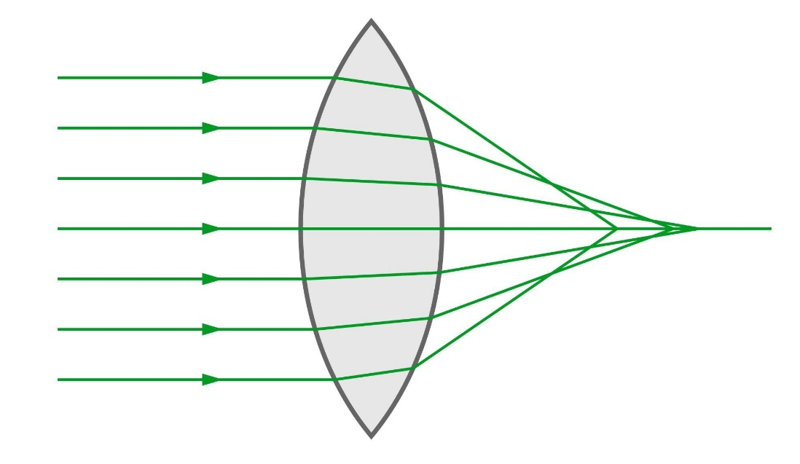
Monochromatic Aberrations- Spherical Aberration
Caused by spherical lens surfaces
Marginal rays focus at a different point than paraxial rays
Effect:
Blurred image even on the optical axis
Fix:
Aspherical lenses
Aperture stop reduction

Slide 29
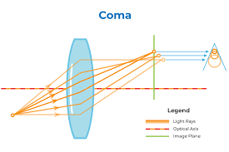
Coma
Off-axis aberration
Magnification varies with aperture height
Effect:
point image becomes comet-shaped
Absent on optical axis

Slide 30
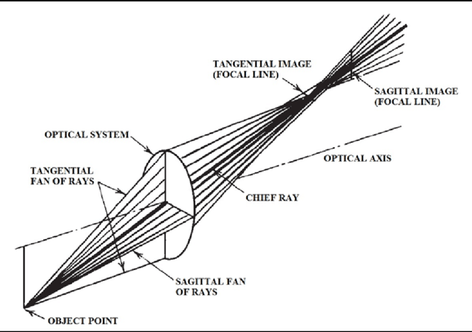
Astigmatism
Tangential and sagittal rays focus at different distances
Effect:
image of a point becomes two orthogonal line foci
Key surfaces: tangential focus, sagittal focus

Slide 31
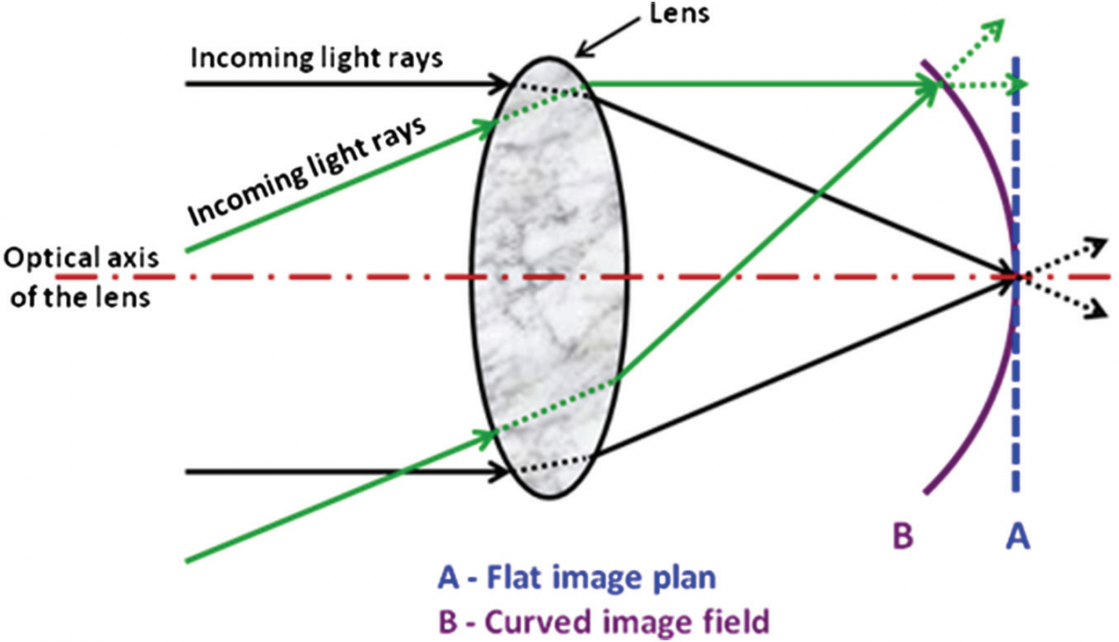
Field Curvature (Petzval Curvature)
Image surface is curved
Center and edges cannot be focused simultaneously on a flat screen
Key visual cue:
🌙 Curved image plane

Slide 32
Distortion
Distortion occurs because lateral magnification varies with field height (distance of the object point from the optical axis).
In an ideal lens, magnification is constant across the field.
In a real lens, magnification changes for off-axis points.
Image shape changes, but sharpness remains
Types:
Barrel distortion → image bulges outward
Pincushion distortion → image pinches inward

Slide 33
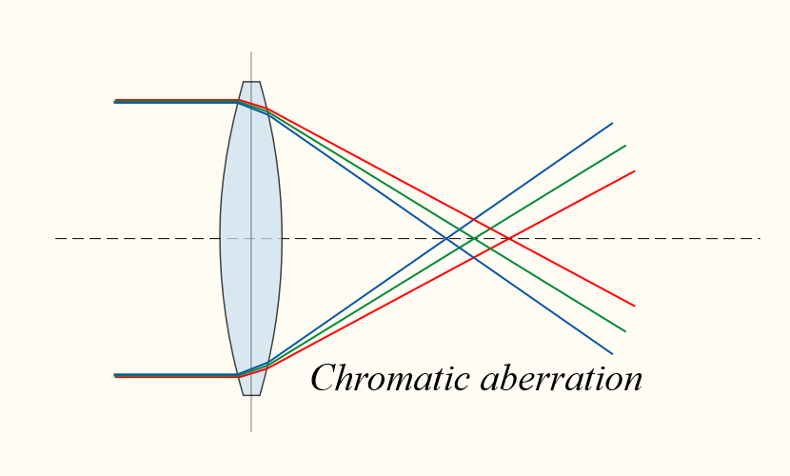
Chromatic Aberrations
Caused by wavelength-dependent refractive index
Different colours focus at different positions because: n = f(λ)
Types:
Longitudinal (axial): Colours focus at different distances along the axis
Lateral (transverse): Colours focus at different magnifications
Effect:
Colour fringes (purple/green edges)
Loss of contrast
Fix:
Achromatic doublets
Apochromatic lenses

Slide 34
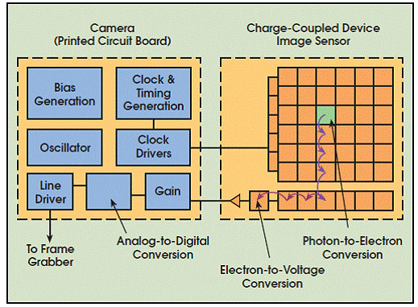
CCD Camera (Charge Coupled Device)
Incoming light generates charge packets in each pixel.
Charges are shifted across the chip (like a bucket brigade) to a single output amplifier.
Conversion to voltage happens outside the pixel array.

Slide 35
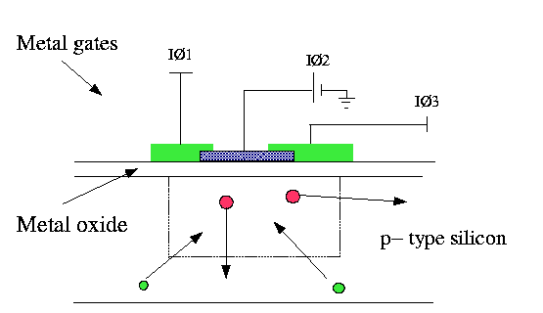
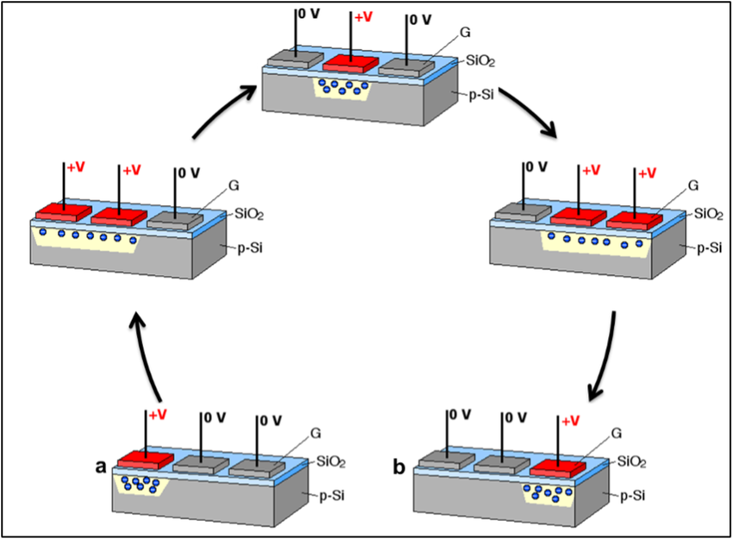
CCD Working

Slide 36
CCD
Key Characteristics
Major Applications
Very low noise
Excellent image uniformity
High dynamic range
Higher power consumption
Slower readout
More expensive manufacturing
Scientific imaging
Astronomy
High-end microscopy
Medical imaging (older systems)

Slide 37
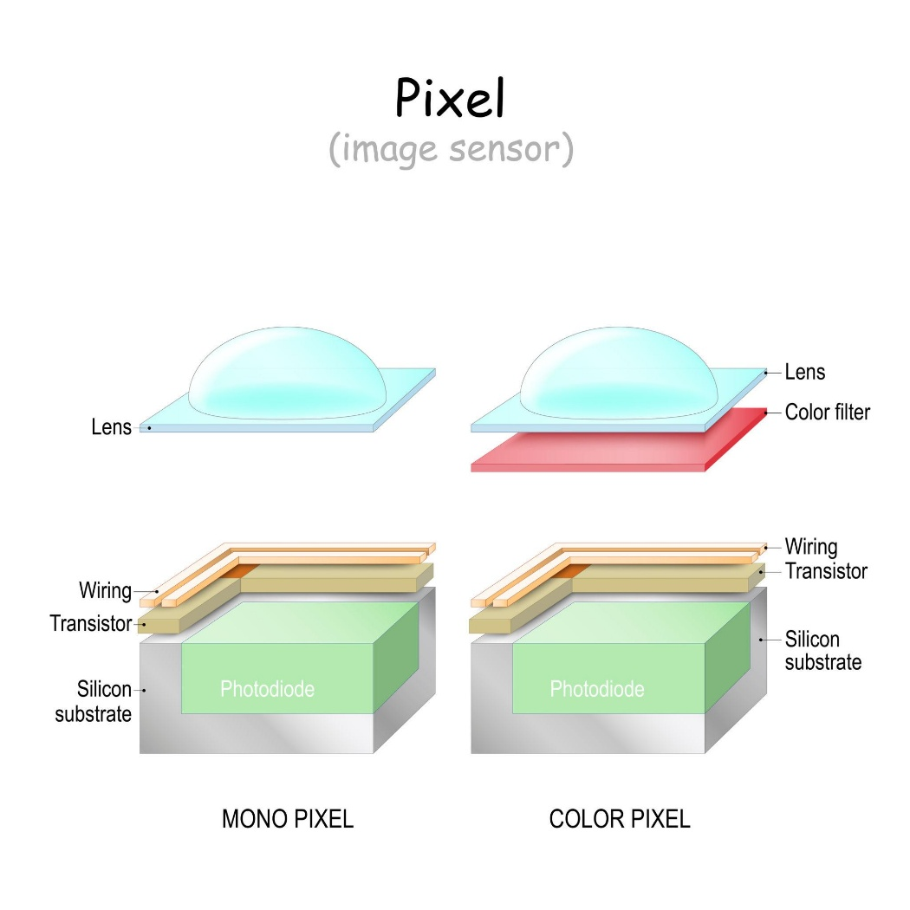
CMOS Cameras (Complementary Metal-Oxide Semiconductor)
Each pixel has its own amplifier and readout circuitry.
Signal is converted to voltage inside the pixel.
Pixels are read row by row.

Slide 38
CMOS
Key Characteristics
Applications
Low power consumption
High speed
Low cost
On-chip processing possible
More noise (older CMOS; modern ones are excellent)
Rolling shutter artifacts (in many sensors)
Mobile phone cameras
Webcams
Surveillance cameras
Embedded vision (ESP32-CAM, Raspberry Pi Camera)

Slide 39
CCD vs CMOS
Feature | CCD | CMOS
Noise | Very low | Low (modern CMOS)
Speed | Slower | Faster
Power | High | Low
Cost | High | Low
Integration | External ADC | On-chip ADC
Shutter | Global | Rolling / Global

Slide 40
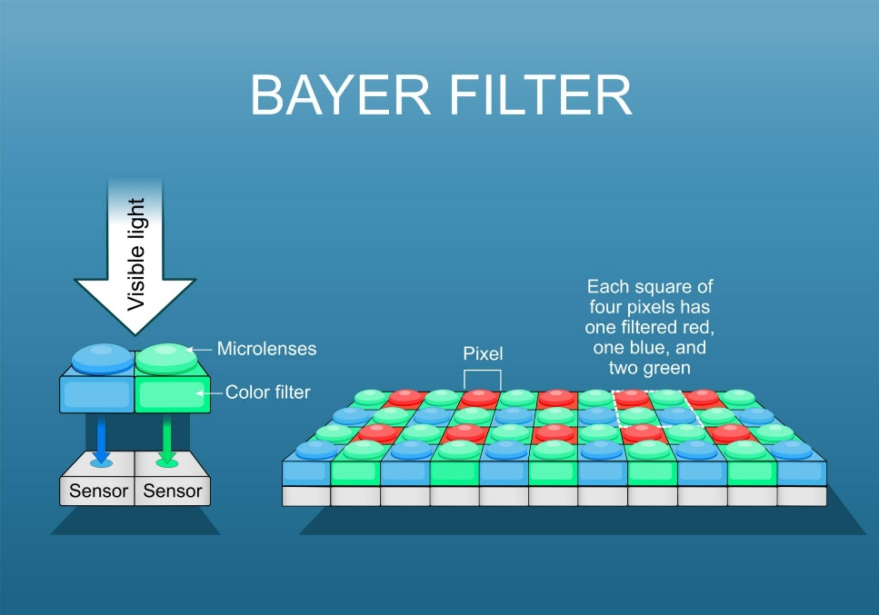
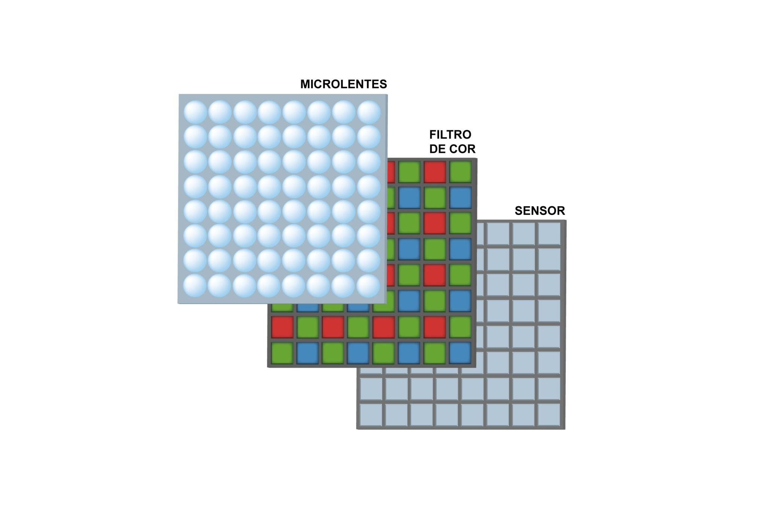
Colour Cameras
Image sensors are naturally monochrome
To capture color, we use color separation techniques.
Two main approaches:
Single-chip colour cameras
Three-chip (3-CCD / 3-CMOS) cameras
Micro lens
Filter
Sensor

Slide 41
Single Chip Camera
A Bayer filter array is placed on top of the sensor.
Each pixel sees only one color:
50% Green
25% Red
25% Blue
Missing colors are reconstructed using demosaicing algorithms.

Slide 42
Single Chip Colour Camera
Key Characteristics
Applications
Compact
Low cost
Low power
Ideal for embedded systems
Lower colour accuracy
Reduced resolution per colour
Colour artifacts possible
Smartphones
Consumer cameras
Machine vision (cost-sensitive)
IoT & embedded cameras

Slide 43
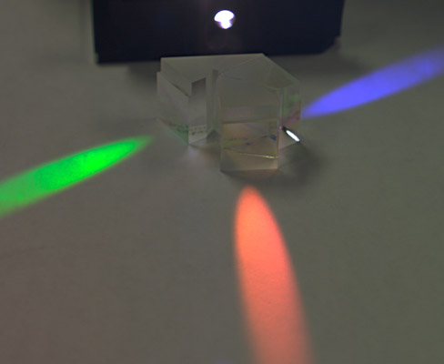
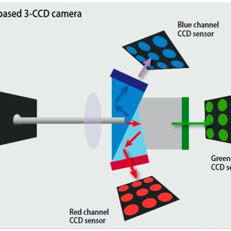
Three-Chip (3-CCD / 3-CMOS) Colour Cameras
Incoming light passes through a dichroic prism.
Light is split into:
Red → Sensor 1
Green → Sensor 2
Blue → Sensor 3
Each sensor captures full resolution for its colour.

Slide 44
CMOS
Key Characteristics
Applications
Excellent color accuracy
High resolution
No demosaicing artifacts
Superior image quality
Bulky
Expensive
Precise optical alignment needed
Broadcast cameras
Cinematography
High-end industrial inspection
Scientific imaging

Slide 45
Camera Performance Parameters-Resolution
Number of pixels in the image (Width × Height).
Example:
640 × 480 (VGA)
1920 × 1080 (Full HD)
4K (3840 × 2160)
Key Points:
Higher resolution → more detail
Larger storage
Higher processing load
More memory usage

Slide 46
Sensitivity(ISO)
Ability of camera sensor to capture light.
Measured in:
ISO number
Lux rating
Responsivity (A/W in scientific sensors)
Important: High sensitivity → works in low light But may increase noise

Slide 47
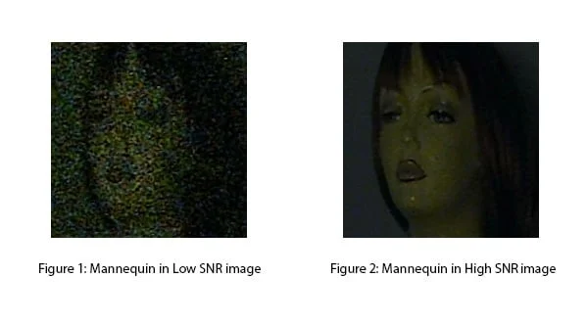
Signal to Noise Ratio
Ratio of useful signal to unwanted noise.

Slide 48
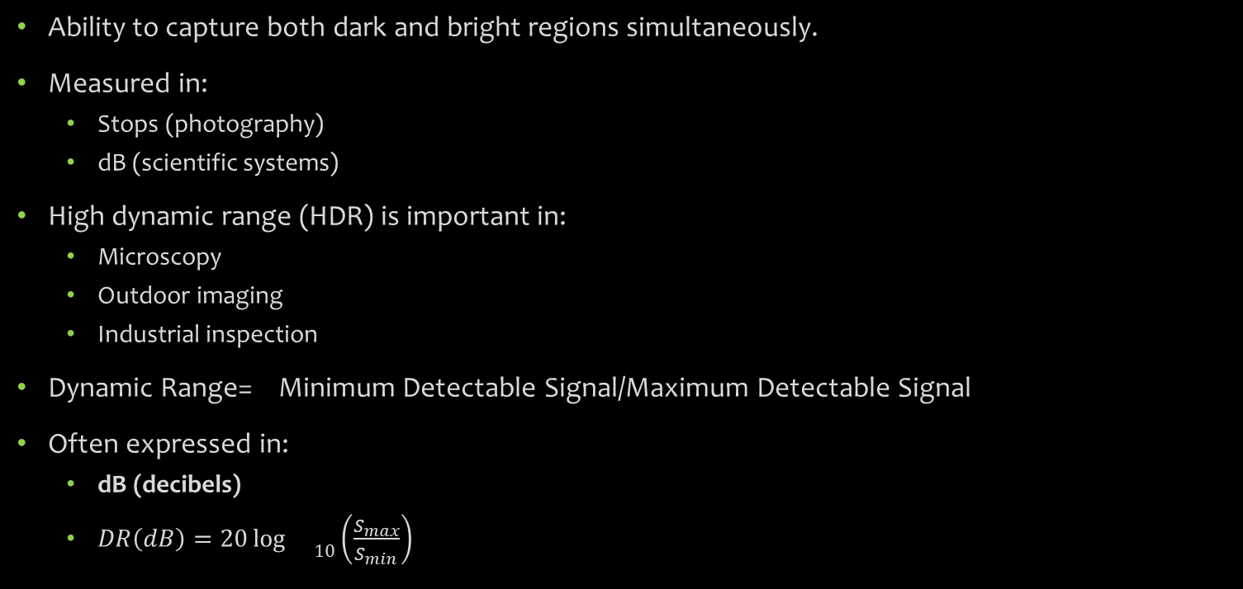
Dynamic Range
Ability to capture both dark and bright regions simultaneously.
Measured in:
Stops (photography)
dB (scientific systems)
High dynamic range (HDR) is important in:
Microscopy
Outdoor imaging
Industrial inspection
Dynamic Range= Minimum Detectable Signal/Maximum Detectable Signal​
Often expressed in:
dB (decibels)
$DR\left(dB\right)=20{\log{}}_{10}\left(\frac{S_{max}}{S_{min}}\right)$

Slide 49
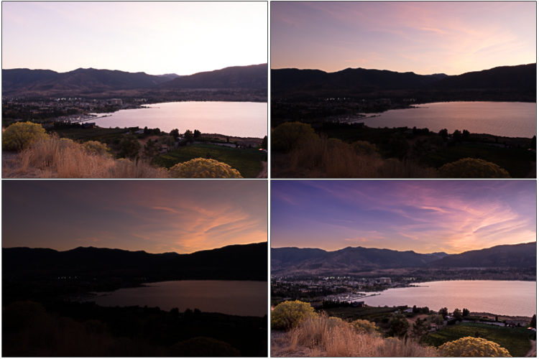
Example

Slide 50
Frame Rate(FPS)
Number of frames captured per second.
Examples:
30 FPS → normal video
60 FPS → smooth motion
120+ FPS → slow motion
In robotics or pick-and-place systems:
High FPS → better real-time control

Slide 51
Pixel Size
Larger pixel:
More light captured
Better low-light performance
Better SNR
Smaller pixel:
Higher resolution
But less light per pixel
Trade-off between:
Resolution vs Sensitivity

Slide 52
Field of View(FOV)
Area covered by the camera lens.
Wide FOV:
Surveillance
Robotics navigation
Narrow FOV:
Microscopy
Precision inspection

Slide 53
Latency
Time between image capture and output availability.
Critical for:
Robotics
Autonomous systems
Real-time control

Slide 54
Bit depth
Number of intensity levels per pixel.
8-bit → 256 levels
10-bit → 1024 levels
12-bit → 4096 levels
16-bit → 65536 levels
Higher bit depth:
Better quantitative analysis
Essential for medical imaging

Slide 55
Dark Current
Important in scientific cameras.
Even in complete darkness, some electrons are generated.
More dark current:
More noise
Reduced accuracy
Critical in:
Fluorescence imaging
Long exposure microscopy

Slide 56
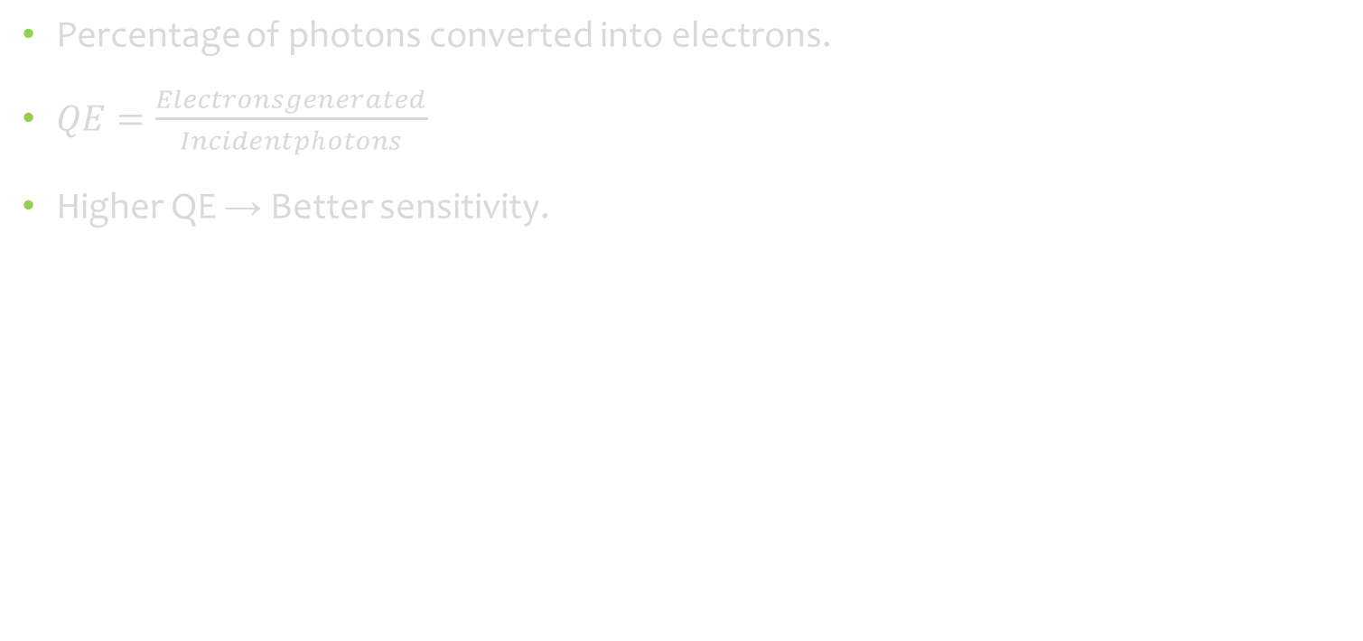
Quantum Efficiency
Percentage of photons converted into electrons.
$QE=\frac{Electronsgenerated}{Incidentphotons}$
Higher QE → Better sensitivity.

Slide 57
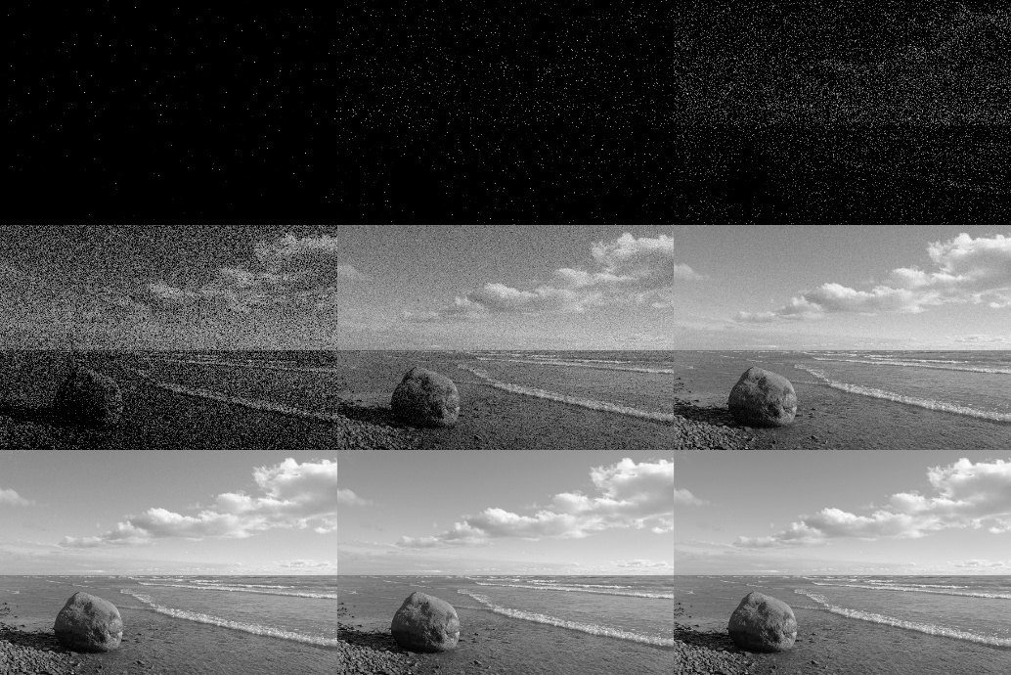
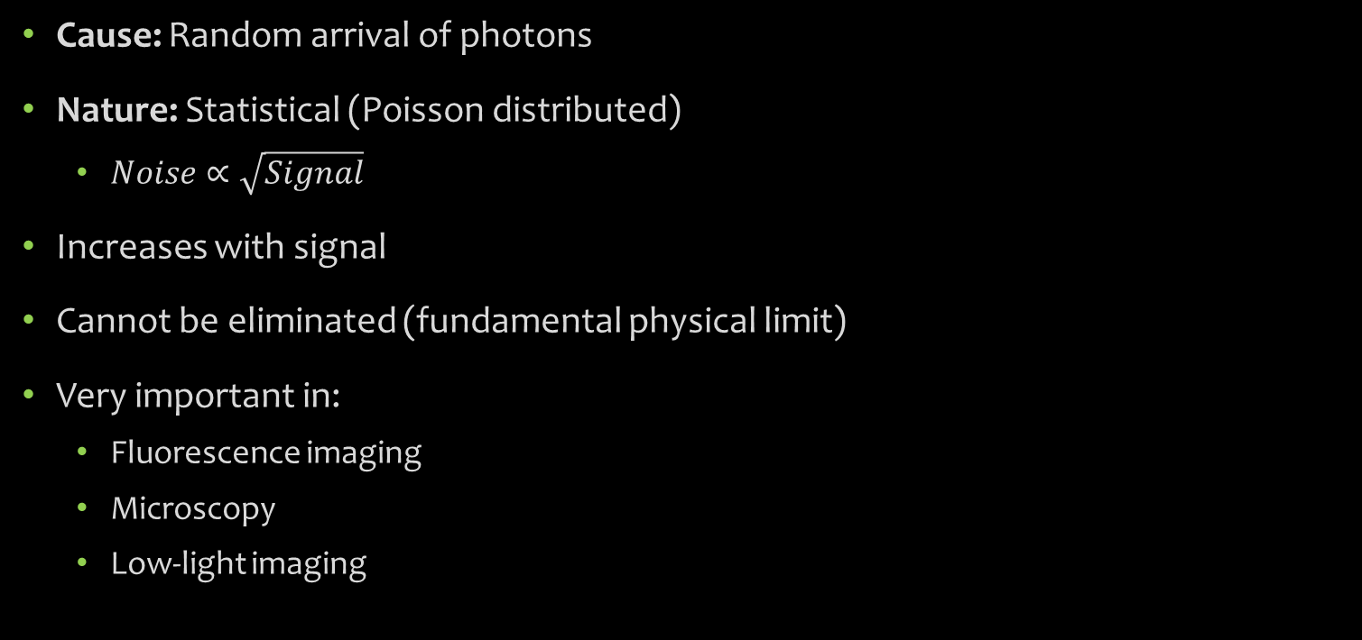
Noises In Camera –Shot Noise
Cause: Random arrival of photons
Nature: Statistical (Poisson distributed)
$Noise∝\sqrt{Signal}$
Increases with signal
Cannot be eliminated (fundamental physical limit)
Very important in:
Fluorescence imaging
Microscopy
Low-light imaging

Slide 58
Thermal Noise
Generated due to thermal electrons even when no light is present.
✔ Increases with temperature ✔ Reduced using cooling (scientific CCD/CMOS)

Slide 59
Read Noise
Noise introduced during:
Charge-to-voltage conversion
Analog-to-digital conversion
Independent of light intensity.
Dominant in:
Low signal conditions
Fast readout systems

Slide 60
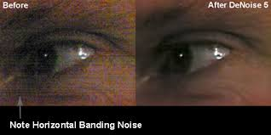
Fixed Pattern Noise
Caused by:
Pixel-to-pixel variation
Manufacturing mismatch
Appears as:
Vertical stripes
Grid patterns
Reduced using:
Calibration
Dark frame subtraction

Slide 61
Quantisation Noise
Occurs due to limited bit depth during ADC.
Example:
8-bit → only 256 intensity levels
12-bit → 4096 levels
Lower bit depth → higher quantization error.

Slide 62
Camera-Computer Interface
Camera-computer interfaces define how digital video data is transferred from a camera sensor to a processing system.
Digital Video Signal
After image capture, the sensor produces digital signals containing:
• Pixel intensity values • Synchronization signals • Clock signals • Control signal

Slide 63
Components of Digital Video Signal
Pixel Data (Parallel/Serial)
Clock Signal
Horizontal Sync (HSYNC)
Vertical Sync (VSYNC)
Frame Valid / Line Valid signals

Slide 64
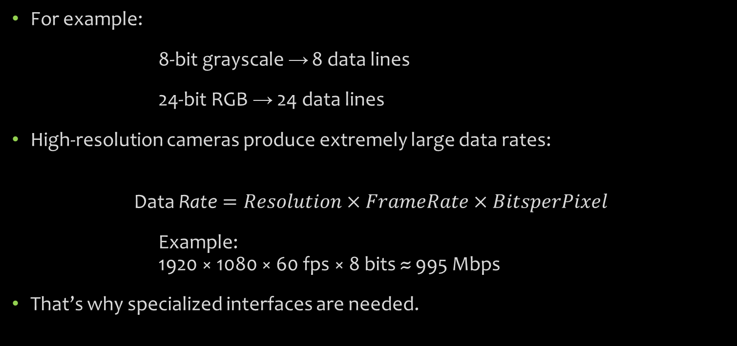
Specialised Interfaces
For example:
8-bit grayscale → 8 data lines
24-bit RGB → 24 data lines
High-resolution cameras produce extremely large data rates:
$$\text{Data} \text{Rate}=Resolution×FrameRate×BitsperPixel$$
Example: 1920 × 1080 × 60 fps × 8 bits ≈ 995 Mbps
That’s why specialized interfaces are needed.

Slide 65
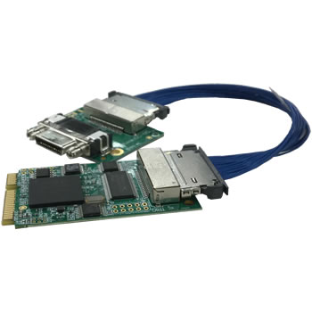
Camera Link
Developed by Automated Imaging Association for industrial vision systems.

Slide 66
Uses:
LVDS (Low Voltage Differential Signaling)
Parallel high-speed transmission
Requires frame grabber card in PC
Mode | Max Data Rate
Base | 255 MB/s
Medium | 510 MB/s
Full | 680 MB/s

Slide 67
Advantages:
✔ Very reliable ✔ Low latency ✔ High bandwidth ✔ Industrial grade
Disadvantages:
✖ Expensive ✖ Requires frame grabber ✖ Short cable length
Used in:
Industrial inspection
Robotics
High-speed imaging

Slide 68
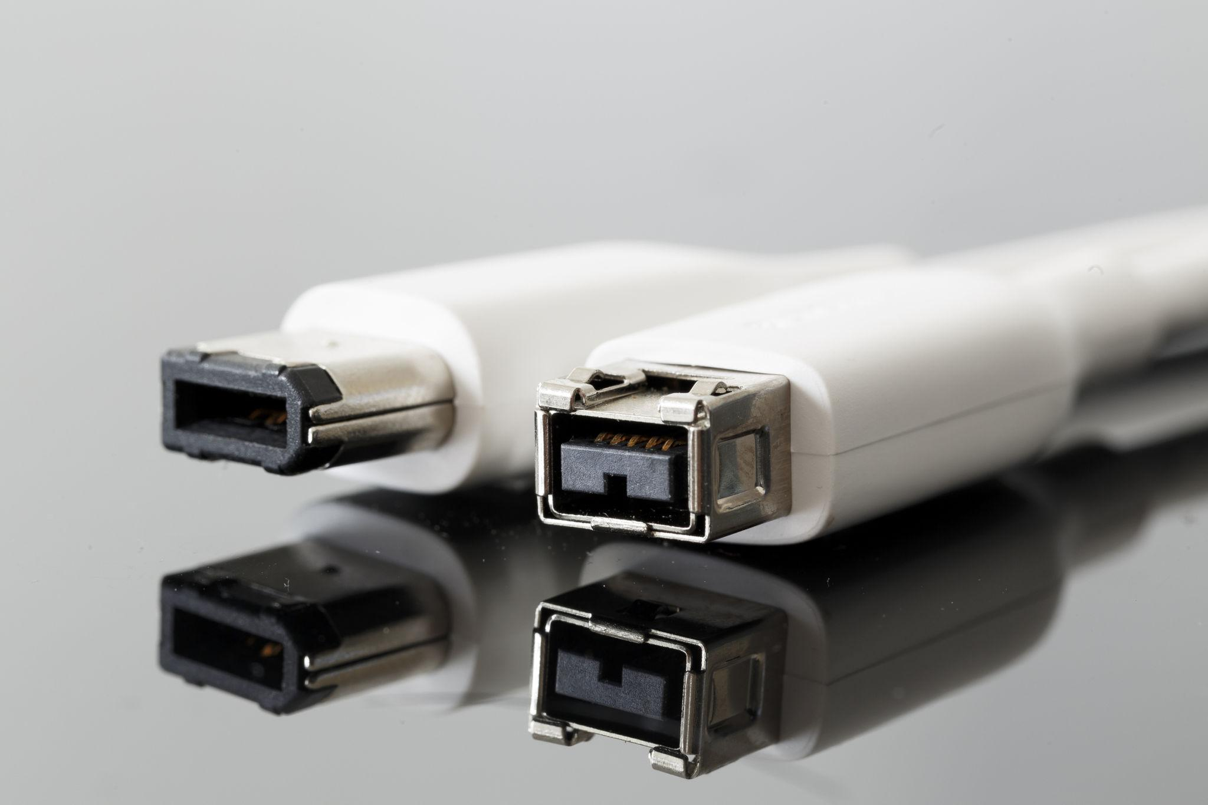
IEEE 1394 (FireWire)
Developed by Apple

Slide 69
Features
Used widely in:
✔ Plug and play ✔ Isochronous transmission (real-time video) ✔ Direct memory access
Limitations:
✖ Becoming obsolete ✖ Limited bandwidth compared to modern standards
Early machine vision systems
Scientific cameras
Video camcorders
Version | Speed
1394a (FireWire 400) | 400 Mbps
1394b (FireWire 800) | 800 Mbps

Slide 70
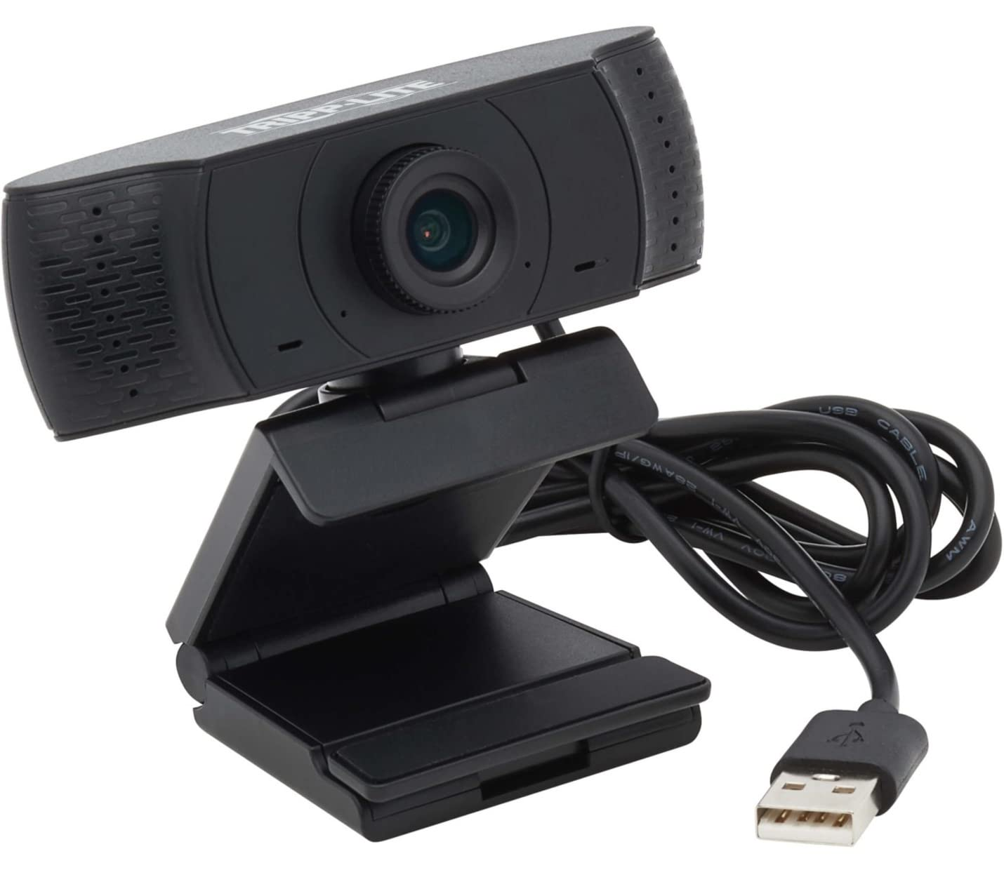
USB 2.0(Universal Serial Bus)
Limitations:
✖ CPU-dependent ✖ Not ideal for very high-speed cameras ✖ Limited cable length (~5m)
Used in:
Webcams
Low-cost vision systems
Embedded imaging
Speed:480 Mbps (theoretical max)
Features:
✔ Very cheap ✔ No frame grabber required ✔ Plug-and-play ✔ Widely supported

Slide 71
Comparison
Feature | Camera Link | IEEE 1394 | USB 2.0
Type | Industrial | Serial bus | Universal bus
Max Speed | 680 MB/s | 800 Mbps | 480 Mbps
Frame Grabber | Required | Not required | Not required
Cost | High | Medium | Low
Usage | Industrial vision | Scientific | Consumer

